Slide 1
Live Long and Prosper
Be like Spock – code like a vulcan

Slide 2
Traits Of Business Software
Good Investment Of Enterprise Resource
Prepared for changing requirements
Low cost of new idea to release of a feature
=> And Maintainable
Quick new feature developent => well Crafted Code
=> And Reliable
Fast Test Feedback => CI

Slide 3
Implementing BDD Makes It Easier
Documentation as Test Case
=> Automated test Cases
=> Quick Feedback
Documentation in the Code
One source of truth
Change of implementation requires change of documentation

Slide 4
BDD – First Description of Behavior
Specification: Stack
Given a new stack is created
Then it is empty
Given not empty stack
When an element is added to the stack
Then that element is at the top of the stack
Given a stack has N elements
And element E is on top of the stack
When element poped of stack
Then operation returns E
And the new size of the stack is N-1

Slide 5
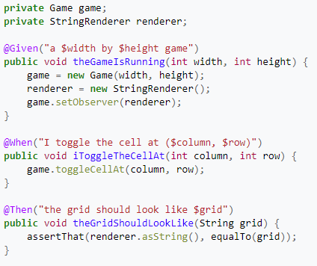
BDD – JBHave

Slide 6
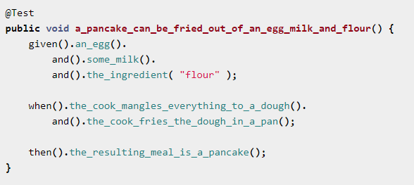
BDD – JGiven

Slide 7
Should you care for automated tests?
At some point you will need them anyway

Slide 8
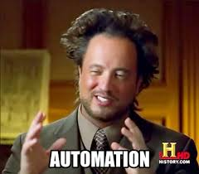

Slide 9
Bad tests generate overhead
You spend time writing them (after writing the code)
Create one happy path per functionality
There is too much excess code for corner cases
You spend time
Fixing not working test
Analyzing what it really tests
assert(true) at the beginning and all is fine
boilerplate not helping
You spend time on figuring out why do they sometimes fail...
Finally you gnore them because there is no time for fixing them.

Slide 10

The Dude

Slide 11
Is there any Cure ?
No there isn’t .
But it’s worth the effort.

Slide 12

What should I do then?
Write them anyway
Be aware of technical debt
Create a maintainable code

Slide 13
BDD + JVM => SPOCK

Slide 14

What is Spock ?
Specification + Mock = Sp - ock
Sp-ecification
Mo-ock
Seriously ?

Slide 15
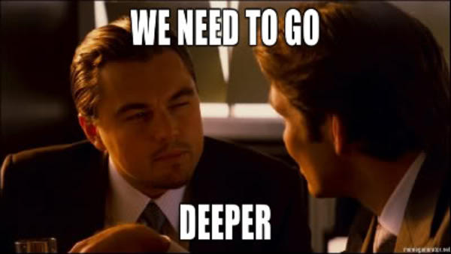

Slide 16

Spock is a Vulcan
Who are vulcans who is Spock and how does it relate to the topic

Slide 17
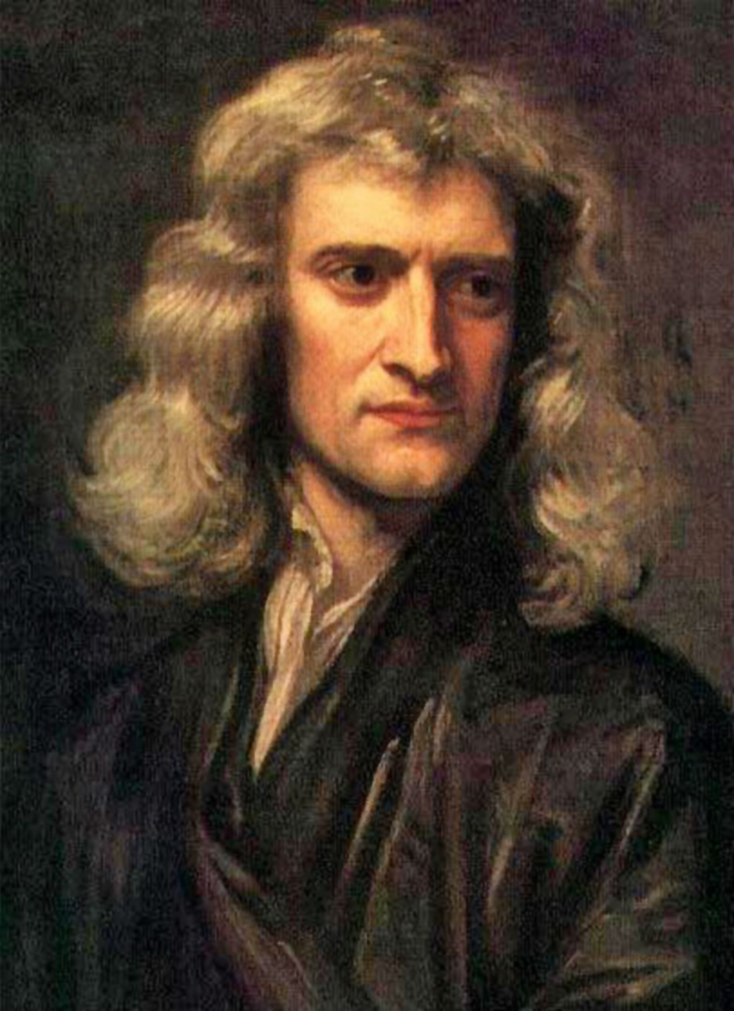
Isaac Newton

Slide 18

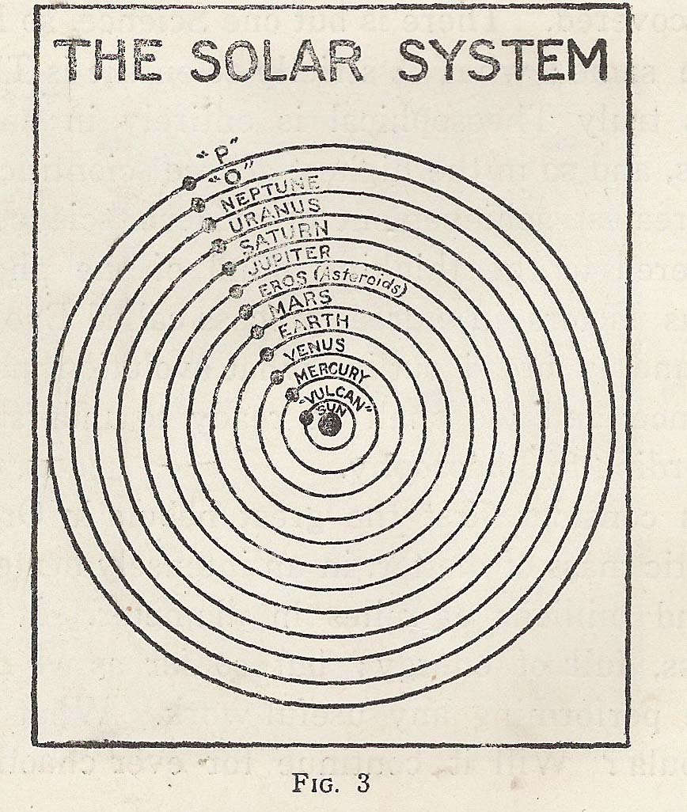
Vulcan Before Einstein
1859, Urbain Le Verrier
The solar system Specification
Given: „The Newtons Laws of Physics”
And: „Orbit of Mercury”
Expect: „a Planet between Sun and Mercury”
https://en.wikipedia.org/wiki/Vulcan_(hypothetical_planet)

Slide 19
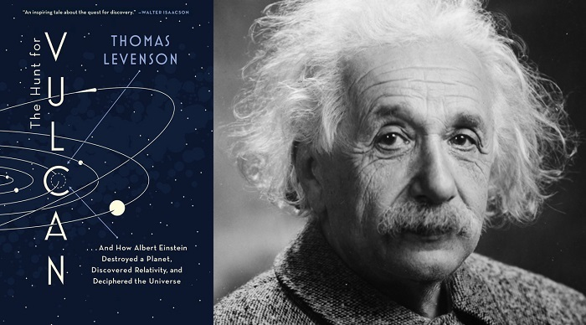
http://www.signature-reads.com/2015/11/that-time-einstein-debunked-vulcan-a-planet-that-never-existed/

Slide 20

Vulcan After Einstein
Fictional planet in the Star Trek universe
Home to Spock and other Vulcans - extra-terrestrial humanoid species in the Star Trek series
A Vulcan follows the path of pure logic.
New Solar system Specification
Given: „Theory Of Relativity”
And: „Orbit of Mercury”
Expect: „no planet between Sun and Mercury”
https://en.wikipedia.org/wiki/Vulcan_(hypothetical_planet)

Slide 21
JUnit to Spock is like Law of Universal Gravitation to Theory of Relativity

Slide 22
Deep Dive
How to write tests using Spock

Slide 23
Login Page - Test NG
public class LogInTests { @Test public void logInWithCorrectCredentials() { WebDriver driver = WebDriverBase.getDriver(false); LogInPage loginPage = new LogInPage(driver); loginPage.correctLogin("andrzej", "123456"); Assert.assertTrue(loginPage.checkLogoutButtonIsDisplayed()); loginPage.clickLogoutButton(); } @Test public void logInWthIncorrectCredentials() { WebDriver driver = WebDriverBase.getDriver(false); LogInPage loginPage = new LogInPage(driver); loginPage.incorrectLogin("andrzej", "Q4mast3r"); Assert.assertEquals(loginPage.getErrorMessage(), ERROR_MESSAGE_TEXT); }
}

Slide 24
Login Page – Groovy Spec – No
@Narrative("""
As a user
I want to access the system
through a login page
""")
class LoginSpec extends UiSpec<LoginPage> {
def "User should be redirected to main page if good credentials else login should fail"() { given: " The login page " when: " user enters credentials and does login action" then: " I land on the main page or am informed that login failed " }
}

Slide 25
Login Page – All in one test
@Narrative("" As a user I want access the system through login page """)
class LoginSpec extends UiSpec<LoginPage> { def "User should be redirected to main page if good credentials else login should fail"() { given: " The login page "
page = new LoginPage().open() when: " I use credentials to login "
MainPage mainPage = page.signIn(new Login(userLogin, password),false) then: " I land on the main page or am informed that login failed "
success ? mainPage.welcomeMessage.text == "Welcome ${userName}" : page.alertDanger.text == invalidDataMsg cleanup: UiDriverFactory.dispose() where: userLogin | password | userName | invalidDataMsg || success "andrzej" | "123456" | "Andrzej Gdula" | _ || true "andrzej" | "Q4mast3r"| _ | ERROR_MSG || false "XXX" | "admin" | _ | ERROR_MSG || false } }
static def ERROR_MSG = "Invalid username or password."

Slide 26
Login Page – Sample Error Message
success ? mainPage.welcomeMessage.text == "Welcome ${userName}" : page.alertDanger.text == invalidDataMsg
| | | | | |
false | | | | All is OK
| | | false
| | | 24 differences (17% similarity)
| | | (Inva)l(id) (u)s(ername) (or) (password.)
| | | (Al--)l(--) (i)s(------) (OK) (---------)
| | Invalid username or password.
| com.pb.dfworks.uitests.ui.web.UiElement@6e33c391
com.pb.dfworks.uitests.login.page.LoginPage@d816dde

Slide 27
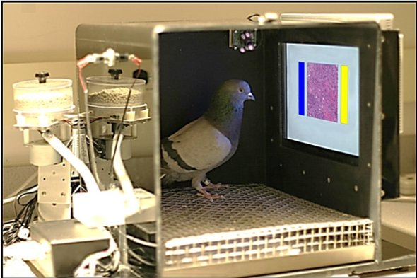
https://www.scientificamerican.com/article/using-pigeons-to-diagnose-cancer/

Slide 28
How to Begin ?

Slide 29
Spock Dependencies
// spock {
testCompile "org.spockframework:spock-core:1.1-groovy-2.4"
// allows mocking of classes (in addition to interfaces) testRuntime "net.bytebuddy:byte-buddy:1.6.5" // allows mocking of classes without default constructor (together with CGLIB)
testRuntime "org.objenesis:objenesis:2.5.1"
// }

Slide 30
What next ?

Slide 31
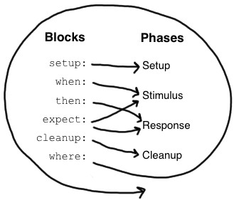
Labels and Execution Phases
def "a brief interaction descrition"(){ given: "some initial state" // or setup: , optional and: "some other initial condition" // optional when: "you do some action" then: "you expect some result" and: "you also expect some other result" // optional
cleanup: "finally cleanup resources" // optional where: "the test data is in vector" // optional } def "a brief expectation descrption"(){ expect: "simple condition" where: "the test data is in vector" // optional }
http://spockframework.org/spock/docs/1.1-SNAPSHOT/

Slide 32
Spock Is So Groovy
http://groovy-lang.org/differences.html
Array intializers,
class, field and method scoping,
non static inner classes,
closures instead of lambas,
Prmitives handling,
Behavior of ==, >, <, ...
GStrings,
Extra keywords eg. in, as
Extra operators ?: , ?. .&, ....

Slide 33
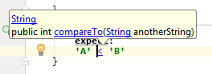
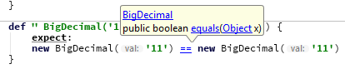
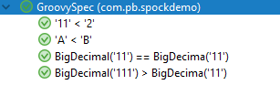
Groovy Operators Specification
def " 'A' < 'B' "() { expect: 'A' < 'B' } def " '11' < '2' "() { expect: '11' < '2' } def " BigDecimal('11') == BigDecima('11') "() { expect: // java == is different new BigDecimal('11') == new BigDecimal('11') } def " BigDecimal('111') > BigDecima('11') "() { expect: new BigDecimal('111') > new BigDecimal('11') }

Slide 34
Groovy Operators Specification
@Unroll("#X compared to #Y is more: #more, equal: #equal, less: #less") def "comparison operators in groovy are working as it is expected "() { expect: "sensible > behavior" ((X > Y) ? true : false) == more and: "sensible == behavior" ((X == Y) ? true : false) == equal and: "sensible < behavior" ((X < Y) ? true : false) == less where: X | Y || more || equal || less "A" | "B" || false || false || true }

Slide 35
Groovy Operators Specification
where: X | Y || more || equal || less "A" | "B" || false || false || true "A" | "A" || false || true || false "B" | "A" || true || false || false
// gotcha "2" | "11" || true || false || false // gotcha
"11" | "2" || false || false || true
// used to be a gotcha ?? "${11 + 1}" | "12" || false || true || false
"2" as BigDecimal | "11" as BigDecimal || false || false || true "11" as BigDecimal | "2" as BigDecimal || true || false || false // java different
"2" as BigDecimal | "2" as BigDecimal || false || true || false

Slide 36
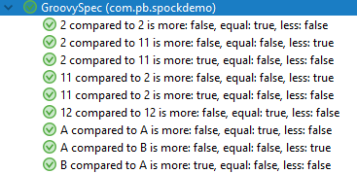
Groovy Operators Specification

Slide 37
Groovy Strings
def x = 1, y = 2
def "Strings in groovy are just much better"() { expect: "groovy interpolates values inside \" " "$x and $y" == "1 and 2"
and: "groovy does not interpolate values inside ' " '$x and $y' == "\$x and \$y" }

Slide 38
Groovy Strings
def "Strings in groovy are just much better"() { expect: "groovy lets you write in multiple lines and not escape\" " """\ "$x" 'and' "$y" """ == '''\ "1" 'and' "2" ''' }

Slide 39
Groovy Strings
def "Strings in groovy are just much better"() { expect: "you can execute a shell command and get it's result in one line„
"cmd /c echo _BB JUG_".execute().text == "_BB JUG_\r\n"
and: "much, more string goodies in groovy" true }
Notes:
<omówić test>

Slide 40
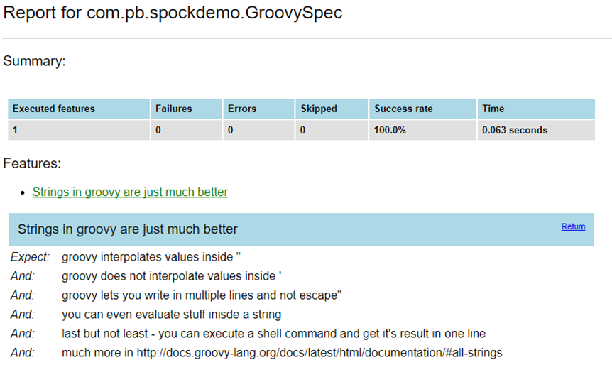
Groovy Strings

Slide 41
Navigate Safely with Elvis
def "Safe navigation ?. operator and elvis ?: are so much shorter than Java ifs"() { given: " that we get an object that might be empty " String iCanBeEmpty = null; expect: " that Safe navigation operator won't let the test blow up " iCanBeEmpty?.length() is null // we could use `==` but `is` looks better and: " the Elvis operator will let you easily define default value" (iCanBeEmpty?.length() ?: -1) != null and: "there is more syntactic sugar in groovy" true }

Slide 42
Groovy Regex
def "Regular expressions are also much more fun"(){ expect: " that boolean pattern matching operator is cool " 'Groovy' ==~ /G.*y/ !('Groovy' ==~ /J.*a/) and: " also you can use the matcher result much easier than in Java " ('this is @VAR A@ and @VAR B@' =~ /@.*?@/)[0] == '@VAR A@' ('this is @VAR A@ and @VAR B@' =~ /@.*?@/)[1] == '@VAR B@' and: "much more tricks with regex in groovy" true }

Slide 43
Maps and Lists
String initials(String name){ name[0] + name[-1] }
def "The fact is that defining structures in groovy is better"() { given: " that creating lists and maps is a breeze "
def myTeam = ["Lukasz M", "Grzegorz K", "Pawel P",
"Marcin A", "Mariusz K", "Andrzej G"]
def peopleRoles = [LM: ["QA"], GK: ["DEV"], MA: ["QA"],
MK: ["DEV"], PP: ["QA"], AG: ["DEV", "TL"]]

Slide 44
Maps and Lists
expect: " that operations on them are also groovy " and: " so we have 3 QA's in the team" myTeam.findAll { 'QA' in peopleRoles[initials(it)] }
== ["Lukasz M", "Pawel P", "Marcin A"]

Slide 45
Maps and Lists
and: " AG is team leader " myTeam.findAll { 'TL' in peopleRoles[initials(it)] } == ["Andrzej G"]

Slide 46
Maps and Lists
def planets = [ 'Vulcan' : [real: false], 'Mercury': [real: true], 'Venus' : [real: true], 'Earth' : [real: true, inhabited : "Yes" ], 'Mars' : [real: true], 'Jupiter': [real: true,], // ... 'Pluto' : [real: false] // but more real than Vulcan :) ]
and: " and something you should really know by now" planets.Earth.inhabited !planets.Mars.inhabited
and: "there is much more in groovy docs "

Slide 47
Files
def " In groovy file operations are groovy too "(){ given: "a Sample text file" def file = new File("./build/test/sampleFile.txt") file.parentFile.mkdirs()
when: " writing to file is one liner" file.text = "Line 1\n„
then: " appending to a file must bee too " file << "Line 2„
and: " reading takes one line as well" String content = file.text content == """Line 1\nLine 2""" }

Slide 48
Urls and Streams
def "In groovy reading from url is as easy as from a file"(){
given: " a website with a PI value " def urlToSiteWithPi = "http://www.geom.uiuc.edu/~huberty/math5337/groupe/digits.html" expect: " that it has the PI " urlToSiteWithPi.toURL().text.contains("3.1415926535897") and: " and if you use it as stream it behaves as the one above " urlToSiteWithPi.toURL()
.withInputStream { is -> is.text }.contains("3.1415926535897") }

Slide 49

There is Much More
but this is out of the scope of this talk

Slide 50

Even More About Spock

Slide 51
Alternative Test Parameters Source
@Shared sql = Sql.newInstance("jdbc:h2:mem:", "org.h2.Driver")
@Unroll("maximum of #a and #b is #c") def ("should find the maximum of two numbers") { expect: Math.max(a, b) == c where: [a, b, c] << sql.rows("select a, b, c from maxdata") }
maximum of 3 and 5 is 5 PASSED
maximum of 7 and 42 is 7 FAILED
Math.max(a, b) == c
| | | | |
| 7 42 | 7
42 false
maximum of 0 and 0 is 0 PASSED
http://spockframework.org/spock/docs/1.1-SNAPSHOT/

Slide 52
where: [a, b, _, c] << sql.rows("select * from maxdata")
where: a = 3 b = Math.random() * 100 c = a > b ? a : b
where: row << sql.rows("select * from maxdata") // pick apart columns a = row.a b = row.b c = row.c
where: a | _ 3 | _ 7 | _ 0 | _ b << [5, 0, 0]
c = a > b ? a : b
where: a << [1, 7, 0] b << [3, 4, 0] c << [3, 7, 0]
http://spockframework.org/spock/docs/1.1-SNAPSHOT/

Slide 53

Mocking

Slide 54
Catching invocations
class PublisherSpec extends Specification { Publisher pub = new Publisher() Subscriber sub1 = Mock() Subscriber sub2 = Mock() def setup() { pub.subscribers << sub1 // << -> List.add() pub.subscribers << sub2 } def "should send messages to all subscribers"() { when: pub.send("hello") then: 1 * sub1.receive("hello") 2 * sub2.receive("hello") // <- error }
}
class Publisher { List<Subscriber> subscribers = [] int messageCount = 0 void send(String message){ subscribers*.receive(message) messageCount++ } } interface Subscriber { void receive(String message) }
Too few invocations for:
2 * sub2.receive("hello") (1 invocation)
http://spockframework.org/spock/docs/1.1-SNAPSHOT/

Slide 55
Mocking – Cardinality, Target, Method
1 * sub1.receive("hello") // exactly one call 0 * sub1.receive("hello") // zero calls (1..3) * sub1.receive("hello") // between one and three calls (inclusive) (1.._) * sub1.receive("hello") // at least one call (_..3) * sub1.receive("hello") // at most three calls _ * sub1.receive("hello") // any number of calls, including zero
1 * _.receive("hello") // a call to any mock object
1 * sub1./r.*e/("hello") // a method name matches the given reg-expr // (here: method name starts with 'r' and ends in 'e')
http://spockframework.org/spock/docs/1.1-SNAPSHOT/

Slide 56
Mocking – Argument Constraints
1 * sub1.receive("hello") // is equal to the String "hello" 1 * sub1.receive(!"hello") // is unequal to the String "hello" 1 * sub1.receive() // empty argument list 1 * sub1.receive(_) // any single argument (incl. null) 1 * sub1.receive(*_) // any argument list (incl. empty arg. list) 1 * sub1.receive(!null) // any non-null argument 1 * sub1.receive(_ as String) // any non-null argument that is-a String
// an argument that satisfies the given predicate // (here: message length is greater than 3) 1 * sub1.receive({ it.size() > 3 })
// multiple method arguments
1 * process.invoke("ls", "-a", _, !null, { ["abcde"].contains(it) })
1 * sub1._(*_) // any method on subscriber, with any argument lis 1 * sub1._ // shortcut for and preferred over the above 1 * _._ // any method call on any mock object 1 * _ // shortcut for and preferred over the above
http://spockframework.org/spock/docs/1.1-SNAPSHOT/

Slide 57
Strict Mocking
when: pub.publish("hello") then: 1 * sub1.receive("hello") // demand one 'receive' call on 'subscriber' _ * auditing._ // allow any interaction with 'auditing' 0 * _ // don't allow any other interaction
http://spockframework.org/spock/docs/1.1-SNAPSHOT/

Slide 58

Stubbing

Slide 59
Kinds Of Fake Objects
Dummy objects are passed around but never actually used. Usually they are just used to fill parameter lists.
Fake objects actually have working implementations, but usually take some shortcut which makes them not suitable for production (an in memory database is a good example).
Stubs provide canned answers to calls made during the test, usually not responding at all to anything outside what's programmed in for the test. Stubs may also record information about calls, such as an email gateway stub that remembers the messages it 'sent', or maybe only how many messages it 'sent'.
Mocks are what we are talking about here: objects pre-programmed with expectations which form a specification of the calls they are expected to receive.
http://martinfowler.com/articles/mocksArentStubs.html
https://stackoverflow.com/questions/3459287/whats-the-difference-between-a-mock-stub

Slide 60
Mocks vs Stubs Behavioral testing vs State testing
https://stackoverflow.com/questions/3459287/whats-the-difference-between-a-mock-stub

Slide 61
Stubbing
Logger logger = Mock() Publisher pub = new Publisher(
responseLogger: logger) Subscriber sub1 = Stub() Subscriber sub2 = Stub() def "should log data from scubscribers"() { given: pub.subscribers << sub1 << sub2 sub1.receive(_) >> "ok" sub2.receive(_) >> { args ->
"received ${args[0]}" } when: pub.send("hello") then: // order does not matter 1 * logger.log("ok") 1 * logger.log("received hello") 0 * logger._ }
class Publisher { Logger responseLogger List<Subscriber> subscribers = [] void send(String message) { subscribers.each { responseLogger.log(
it.receive(message)
) } } } interface Subscriber { String receive(String message) } interface Logger { String log(String message) }
http://spockframework.org/spock/docs/1.1-SNAPSHOT/

Slide 62
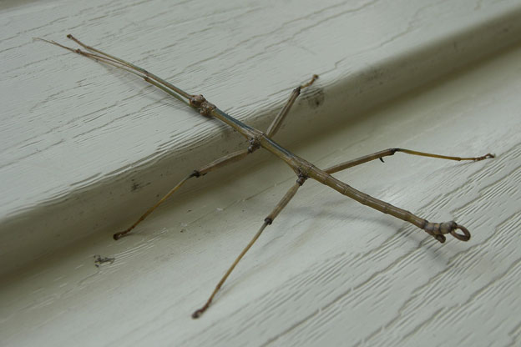
Mocking Static Methods

Slide 63
Mocking Static Methods (Utility Classes)
public class StaticMethodUser { public String read(InputStream in ) throws IOException { return IOUtils.toString(in,"UTF-8"); } public String getSysProp(String property) throws IOException { return System.getProperty(property); } }

Slide 64
Spock + Powermock
// power mock { def pmv = "1.6.6" // max version that works testCompile "org.powermock:powermock-module-junit4-common:$pmv" testCompile "org.powermock:powermock-module-junit4-rule-agent:$pmv" testCompile "org.powermock:powermock-api-mockito:$pmv" testCompile "org.powermock:powermock-classloading-xstream:$pmv" testCompile "org.powermock:powermock-module-junit4:$pmv" // } power mock
// prevent java.lang.VerifyError: Expecting a stackmap frame at branch target
test { jvmArgs "-noverify" }

Slide 65
Mix with PowerMock
@PrepareForTest([IOUtils]) class StaticMethodUserSpec extends Specification{ @Rule PowerMockRule powerMockRule = new PowerMockRule() def "converts input stream to string using IOUtils"() { setup: "IOUtils convert stream to result" mockStatic(IOUtils) when(IOUtils.toString((InputStream)any(InputStream), anyString())) .thenReturn("result") expect: "the result" new StaticMethodUser().read(new ByteArrayInputStream()) == "result" } }

Slide 66
Mix with PowerMock
@PrepareForTest([System]) class StaticMethodUserSpec extends Specification{ @Rule PowerMockRule powerMockRule = new PowerMockRule()
// Sadly - does not work on java.lang.* classes def "reads property from system properties"() { given: mockStatic(System) when(System.getProperty(anyString())).thenReturn("value") expect: new StaticMethodUser().getSysProp("xxx") == "value" } }

Slide 67

Extensions

Slide 68
Built-In Extensions – Skipping Tests
@Ignore("TODO") def "my feature"() { } @IgnoreIf({ System.getProperty("os.name").contains("windows") }) def "I'll run everywhere but on Windows"() {} @Requires({ os.windows }) def "I'll only run on Windows"() { }
http://spockframework.org/spock/docs/1.1-SNAPSHOT/

Slide 69
Built-In Extensions - Timeouts
@Timeout(5) def "I fail if I run for more than five seconds"() { } @Timeout(value = 100, unit = TimeUnit.MILLISECONDS) def "I better be quick"() { } @Timeout(10) class TimedSpec extends Specification { def "I fail after ten seconds"() { } def "Me too"() { } @Timeout(value = 250, unit = TimeUnit.MILLISECONDS) def "I fail much faster"() { } }
http://spockframework.org/spock/docs/1.1-SNAPSHOT/

Slide 70
Built-In Extensions – Run In Order
@Stepwise class RunInOrderSpec extends Specification { def "I run first"() { } def "I run second"() { } }
http://spockframework.org/spock/docs/1.1-SNAPSHOT/

Slide 71
Built-In Extensions – Run In Order
@RestoreSystemProperties def "determines family based on os.name system property"() { given: System.setProperty('os.name', 'Windows 7') expect: OperatingSystem.current.family == OperatingSystem.Family.WINDOWS }
http://spockframework.org/spock/docs/1.1-SNAPSHOT/

Slide 72
Built-In Extensions – More Natural Language
@Title("This is easy to read") class ThisIsHarderToReadSpec extends Specification { /*...*/ }
@Narrative(""" As a user I want foo So that bar """) class GiveTheUserFooSpec { /*...*/ }
@Issue("http://my.issues.org/FOO-1") class MySpec { @Issue("http://my.issues.org/FOO-2") def "Foo should do bar"() { /*...*/ } @Issue(["http://my.issues.org/FOO-3", "http://my.issues.org/FOO-4"]) def "I have two related issues"() { /*...*/ } }
http://spockframework.org/spock/docs/1.1-SNAPSHOT/

Slide 73
Built-In Extensions – Generate Specification
// spock reporting testCompile( 'com.athaydes:spock-reports:1.3.2' ) { transitive = false // this avoids affecting your version of Groovy/Spock }

Slide 74
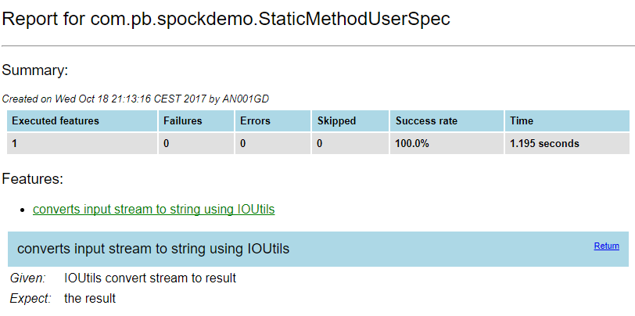
Built-In Extensions – Generate Specification

Slide 75


Slide 76












Still Not Convinced ?
https://code.google.com/archive/p/spock/wikis/WhoIsUsingSpock.wiki

Slide 77
Spock will not make these things for you
Meaningful test names
You have to put effort into making test names so that in future you can use them as a living product spec
Usage of execution phases accordingly
don’t put code that is a setup: code after when: label
Readable code
The code should be like a good joke - If you need to explain it its a bad code. (As @venkat_s once said. )
Meaningful results
You have to put it together so that if a test fails you get a helpful information

Slide 78

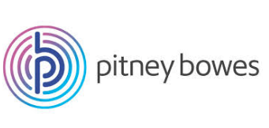
Andrzej Gdula
@drzejk
github.com/agdula

